Slide 1
CLIPMIND AI
Video Summarization & Key Moments Detection Platform
MILESTONE 2
Transcript generation
Summary Generation

Slide 2
AI Transcript & Summary Generation
Objectives:
Generate transcript from uploaded videos.
Generate AI-based summary.
Evaluate summary quality and performance.
Build an interactive user interface.

Slide 3
AI Transcript Generation :
Video is uploaded to the system.
Audio is extracted from the video.
OpenAI Whisper converts speech into text.
Automatically detects the spoken language.
Displays the generated transcript.
Supports keyword search and AI explanation.

Slide 4
Transcript Generation Workflow
Upload Video
↓
Extract Audio
↓
Speech to Text
↓
Generate Transcript
↓
Display Transcript

Slide 5
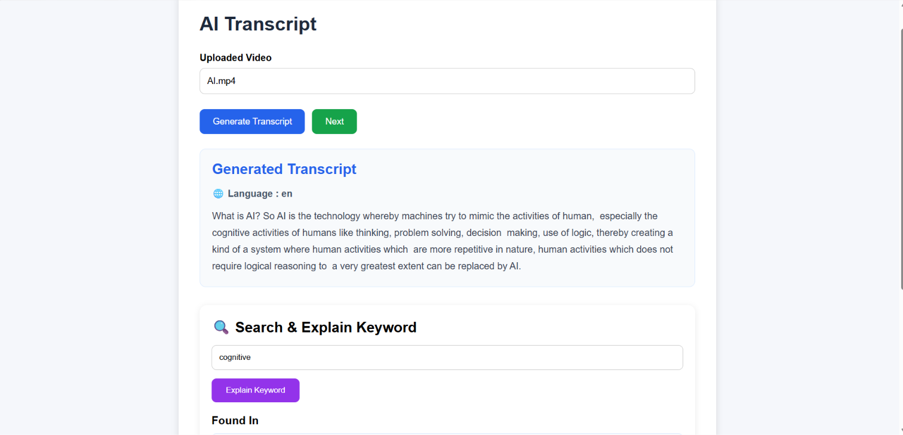
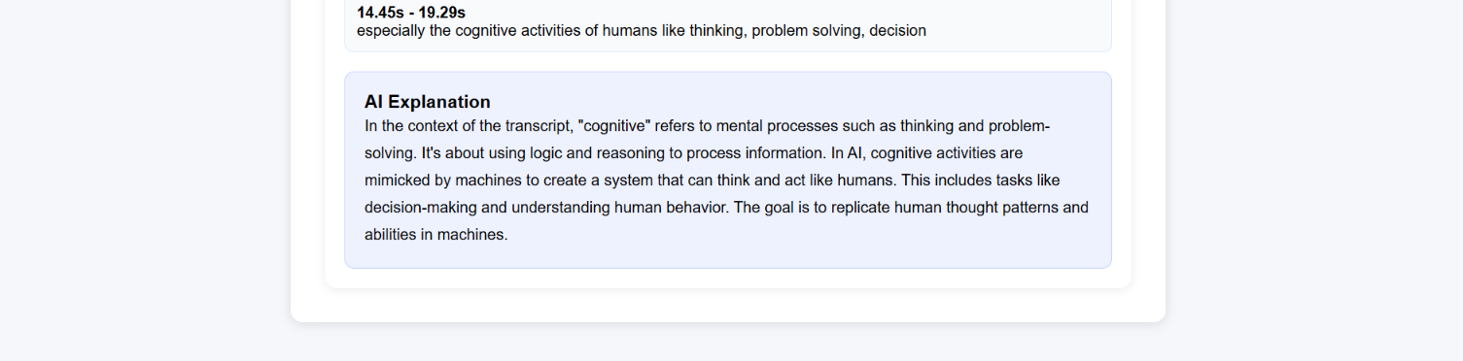

Slide 6
AI Summary Generation :
Uses the generated transcript as input.
BART model generates a concise summary.
Produces important points in readable format.
Reduces lengthy transcripts into short summaries.
Summary is stored for the next modules.

Slide 7
Summary Generation Workflow:
Transcript
↓
AI Processing
↓
Important Points Extraction
↓
Summary Generation
↓
Display Summary

Slide 8
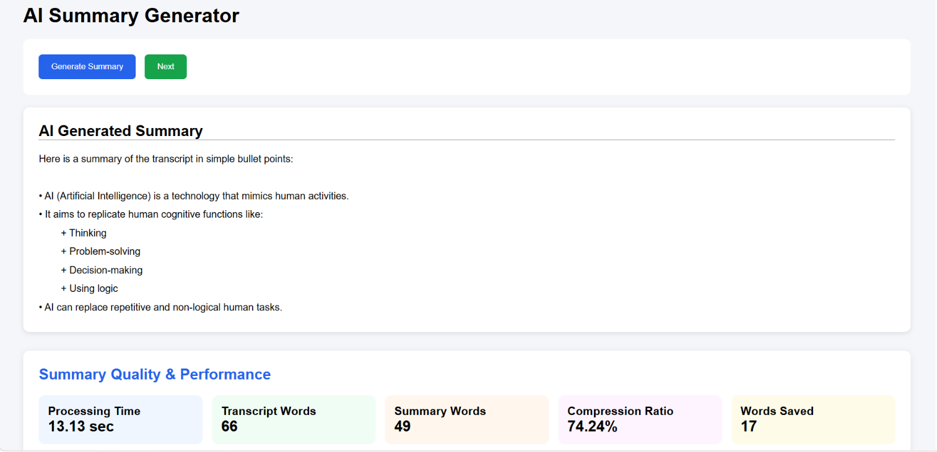
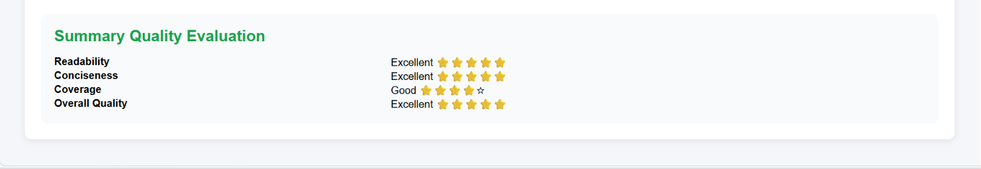

Slide 9
THANK YOU

